Slide 1

SPL - 2 SRS
Personal Health Tracker using Automated Report Scanning
Md. Mahfuz Ibne Ali Ayon
BSSE 1421
Mohammad Ismail Hossain
BSSE 1433
Supervised by
Dr. Ahmedul Kabir
Associate Professor

Slide 2
Quality Function Deployment
Normal Requirements
User Authentication
User Profile
Image Upload Capability
Report scanning functionality
Report Storage and Retrieval

Slide 3
Quality Function Deployment
Expected Requirements
User-Friendly Interface
High Accuracy in Data Extraction
Fast Upload and Processing Time
Automatic Report Categorization
Report Search
History Visualization
Report sharing
Health condition warning

Slide 4
Quality Function Deployment
Exciting Requirements
Health Insights or Trends
Report Summarization
Notify connected users
Easily find other users
Offline Upload
Cross-Platform Availability

Slide 5
Scenario-Based Modeling
(Use Case)

Slide 6
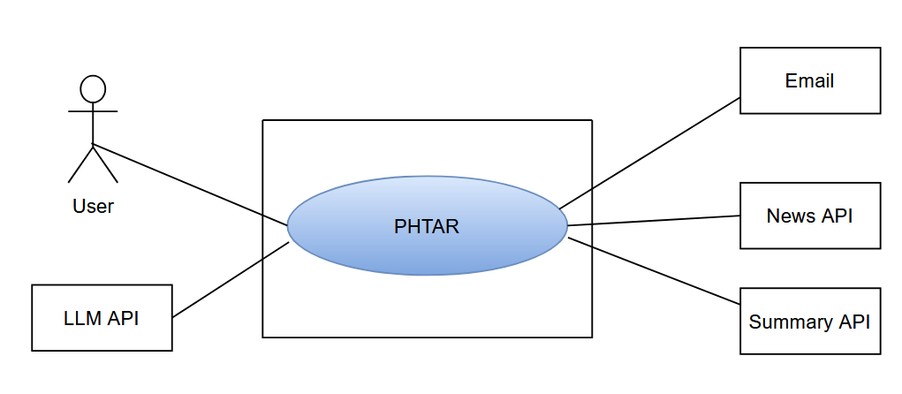
Use case level 0

Slide 7
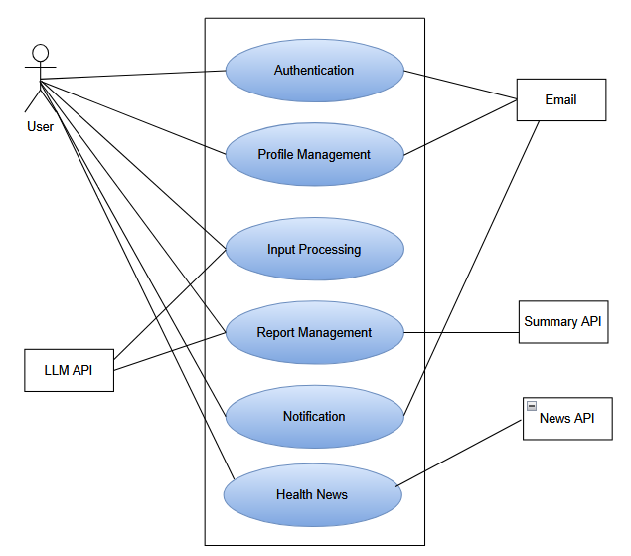
Use case level 1
Personal Health Tracker using Automatic Report Scanning (PHTAR) (Detailed)

Slide 8
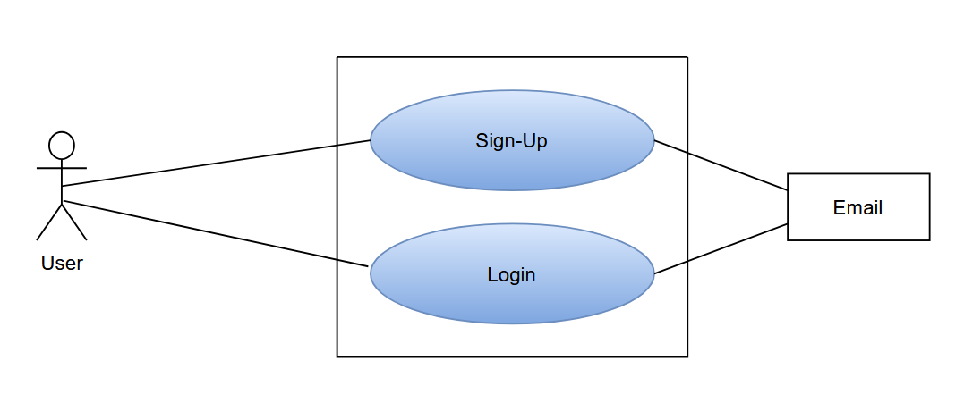
Use case level 1.1
Registration and Authentication System

Slide 9
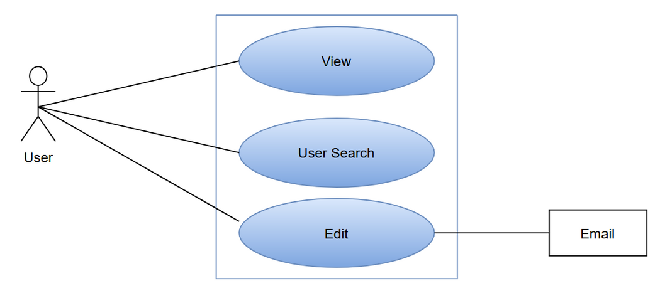
Use case level 1.2
Profile Management

Slide 10
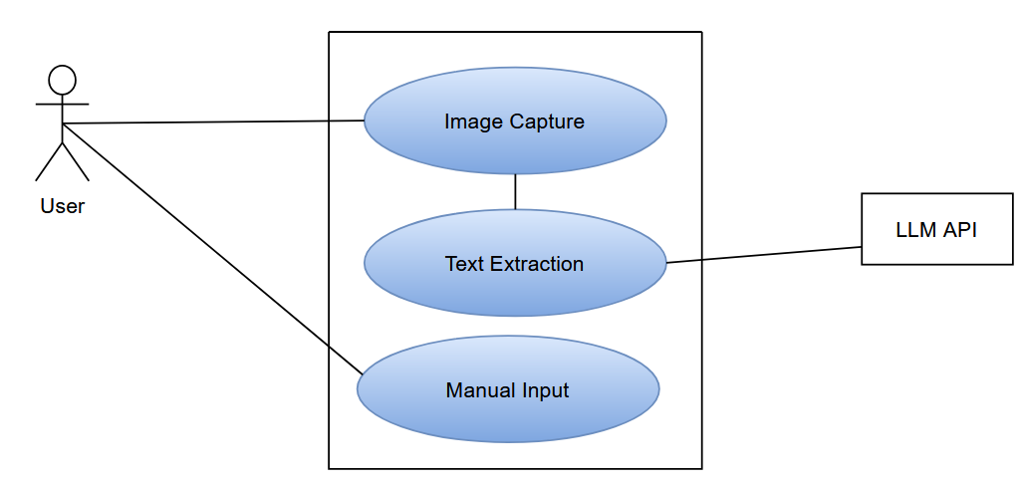
Use case level 1.3
Input Processing

Slide 11
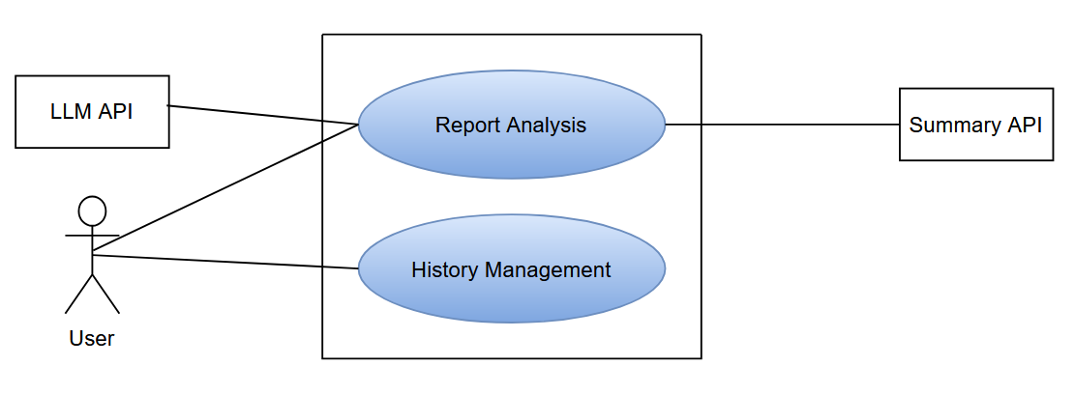
Use case level 1.4
Report Management

Slide 12
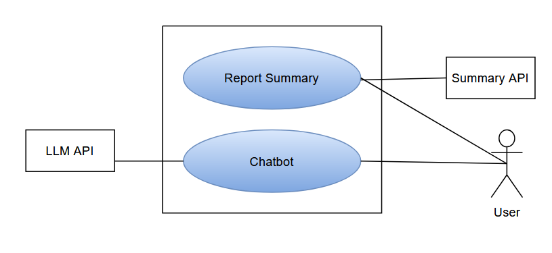
Use case level 1.4.1
Report Analysis

Slide 13
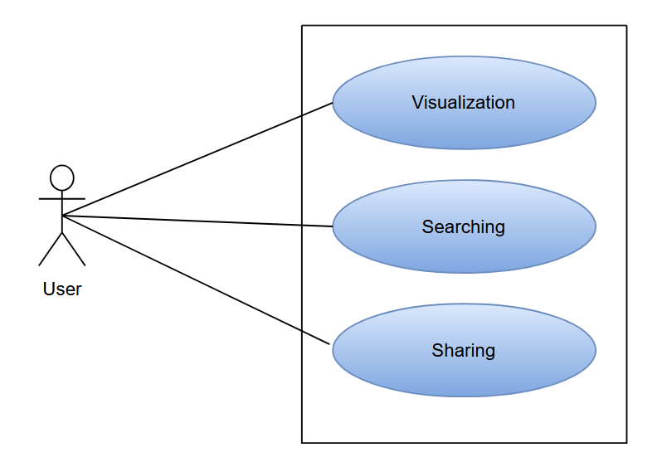
Use case level 1.4.2
History Management

Slide 14
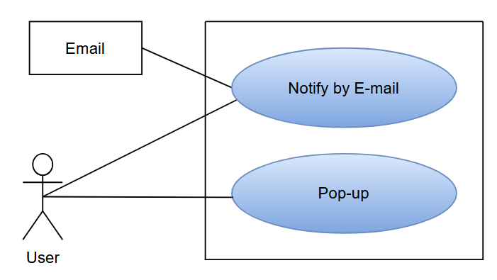
Use case level 1.5
Notification

Slide 15
Scenario-Based Modeling
(Activity Diagram)

Slide 16
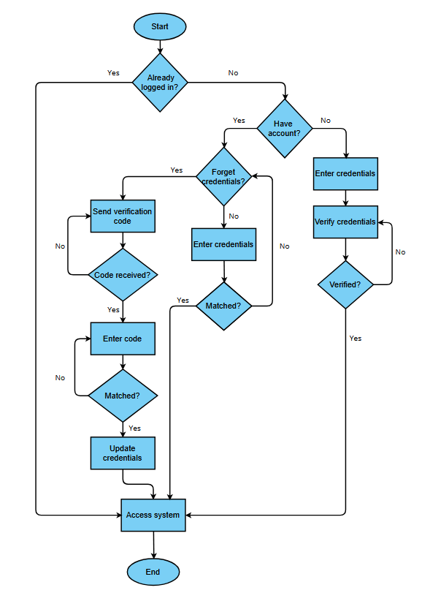
Activity level 1.1
Registration and Authentication System

Slide 17
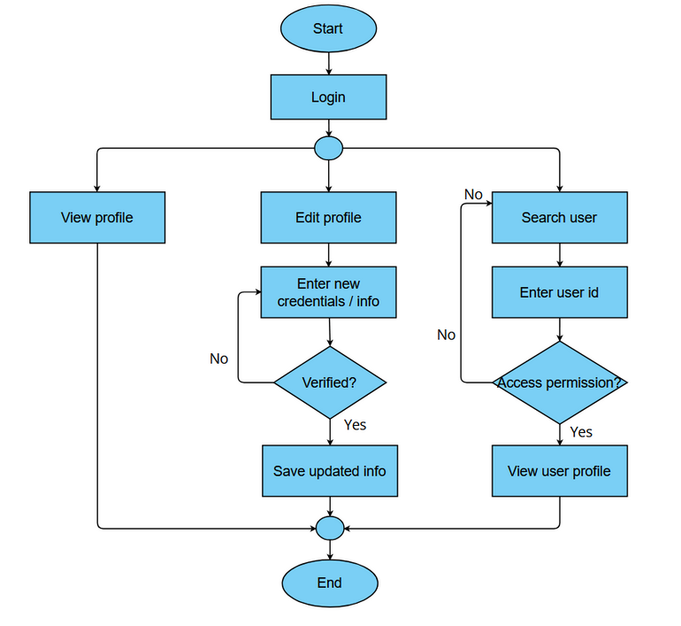
Activity level 1.2
Profile Management

Slide 18
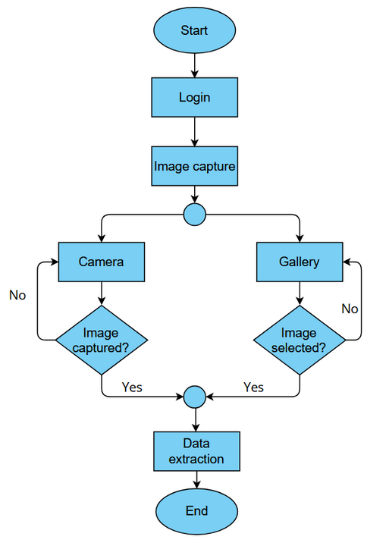
Activity level 1.3.1
Image capture

Slide 19
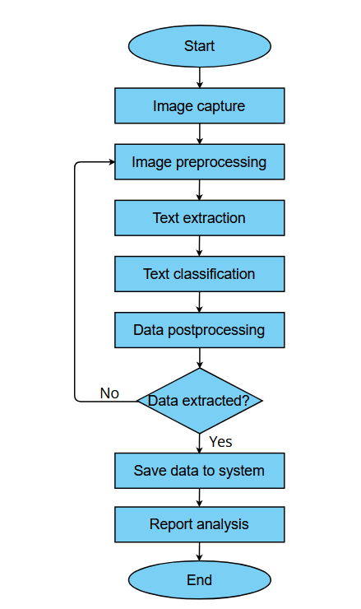
Activity level 1.3.2
Data extraction

Slide 20
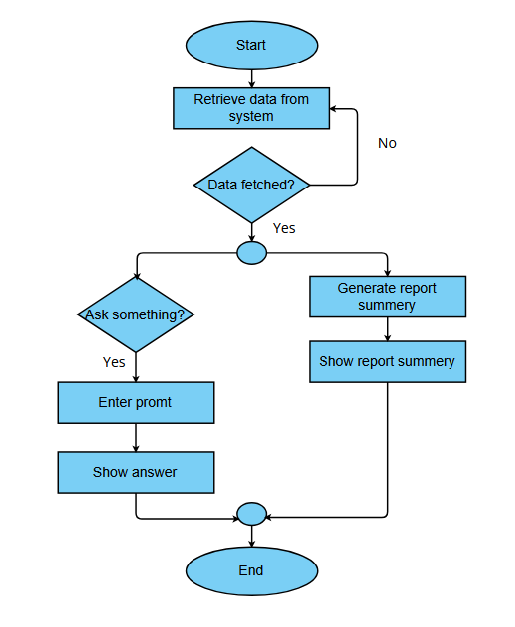
Activity level 1.4.1
Report analysis

Slide 21
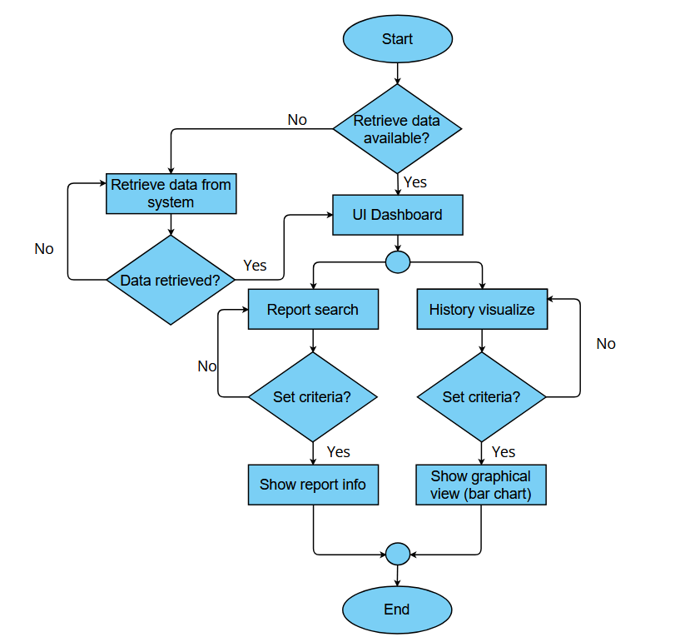
Activity level 1.4.2
History management

Slide 22
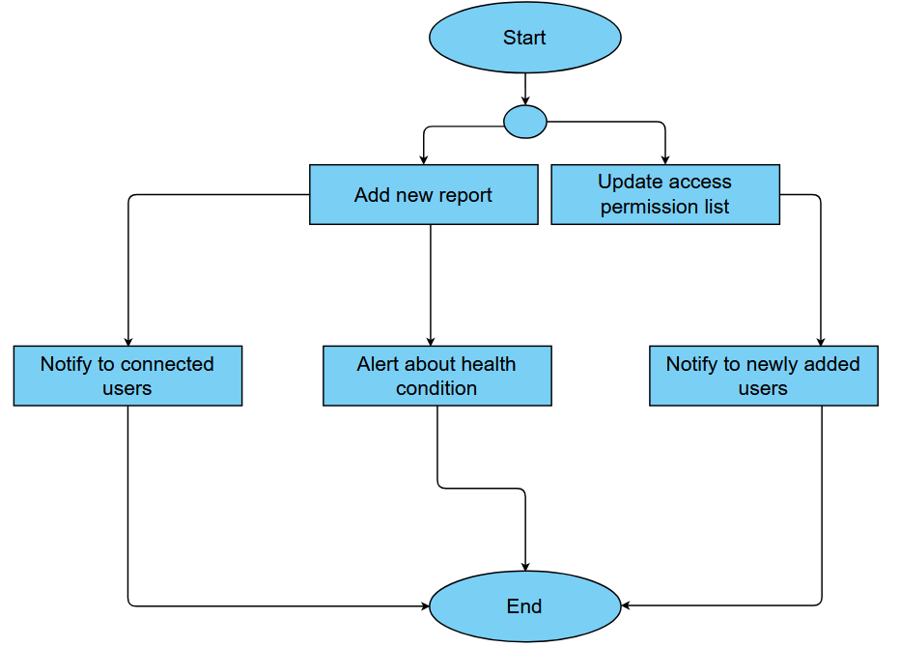
Activity level 1.5
Notification

Slide 23
Scenario-Based Modeling
(Swim lane Diagram)

Slide 24
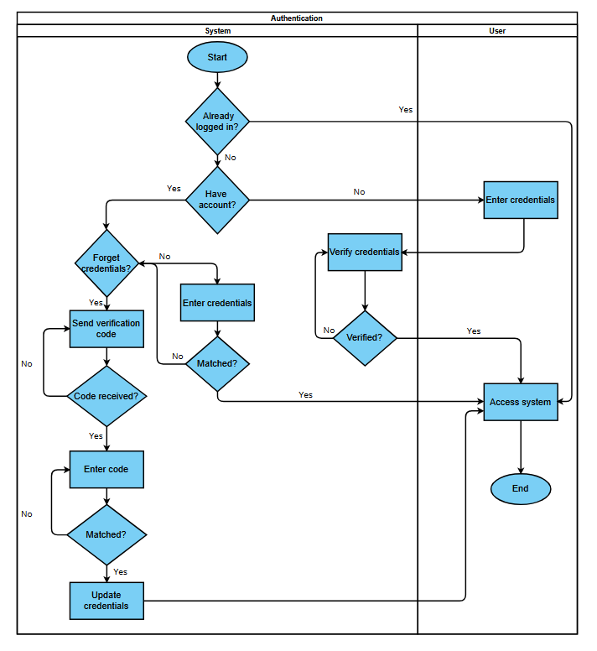
Swim lane level 1.1
Registration and Authentication System

Slide 25
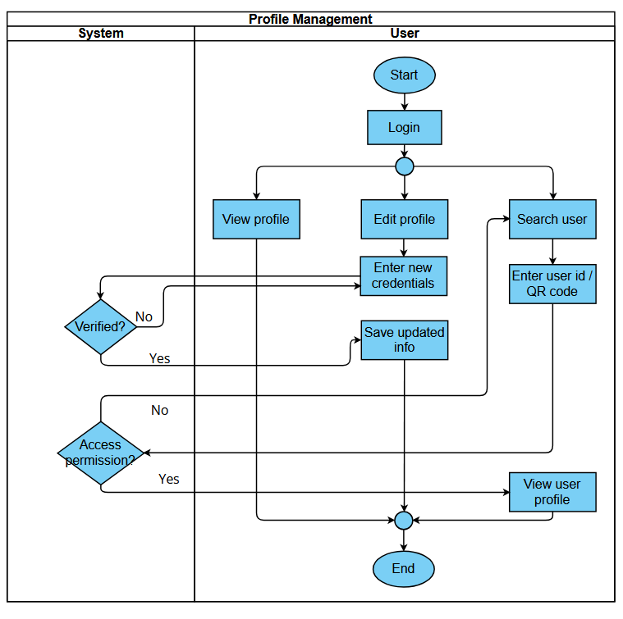
Swim lane level 1.2
Profile Management

Slide 26
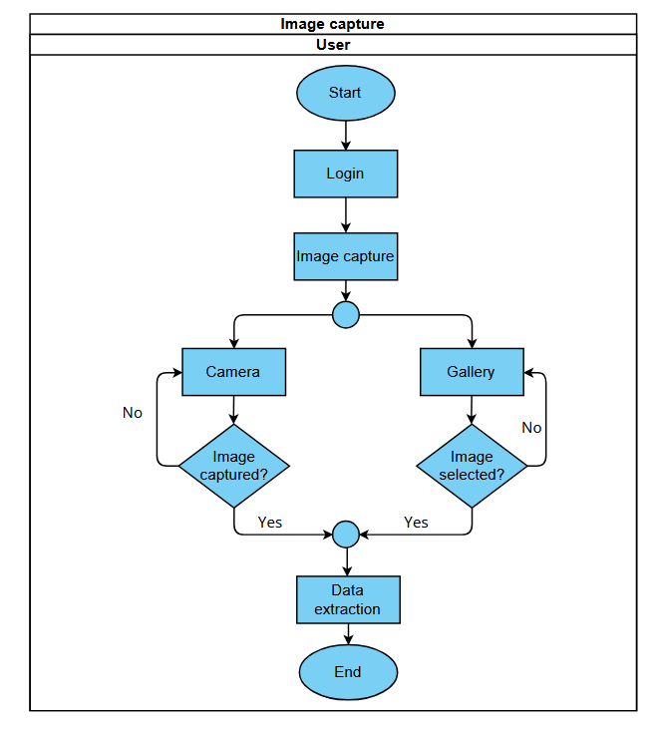
Swim lane level 1.3.1
Image capture

Slide 27
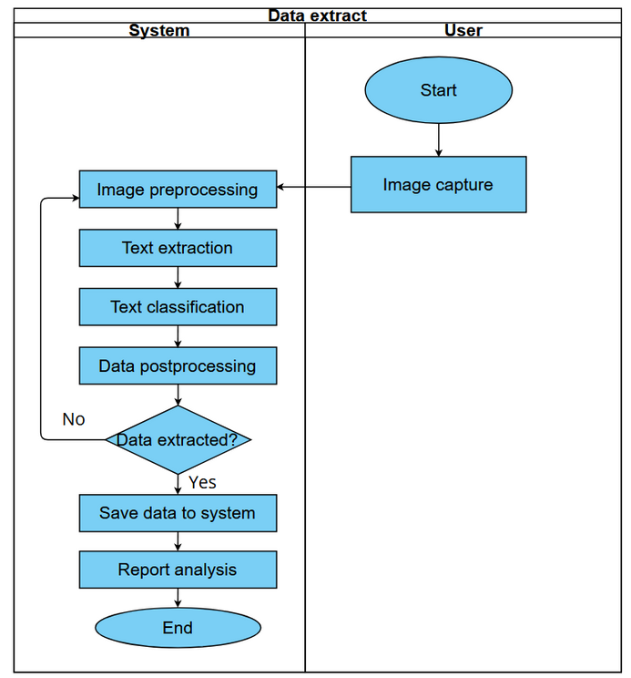
Swim lane level 1.3.2
Data extraction

Slide 28
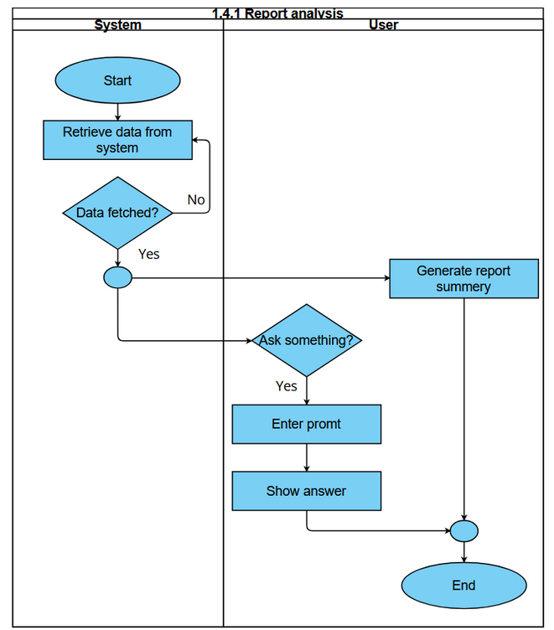
Swim lane level 1.4.1
Report analysis

Slide 29
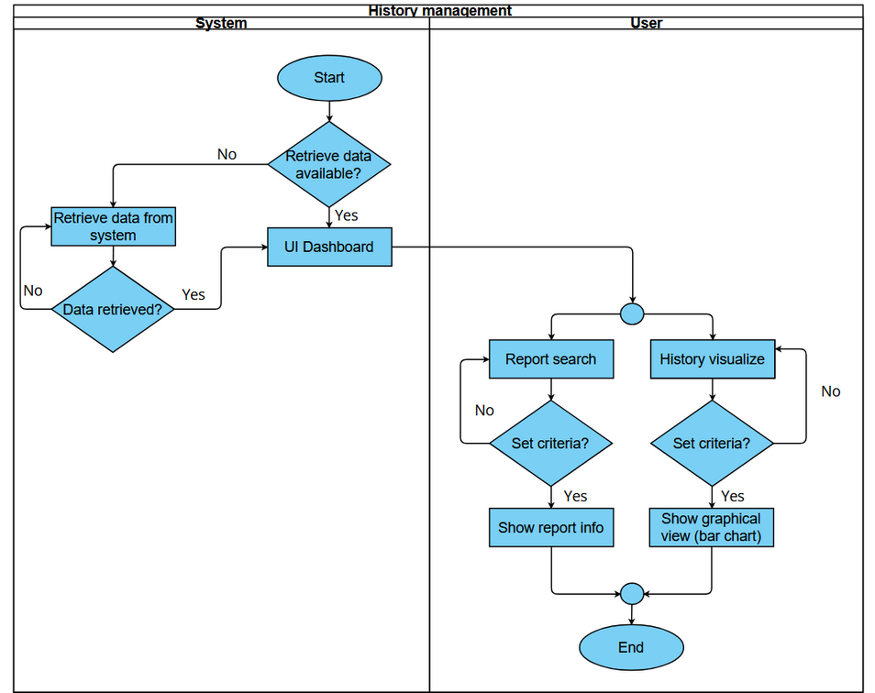
Activity level 1.4.2
History management

Slide 30
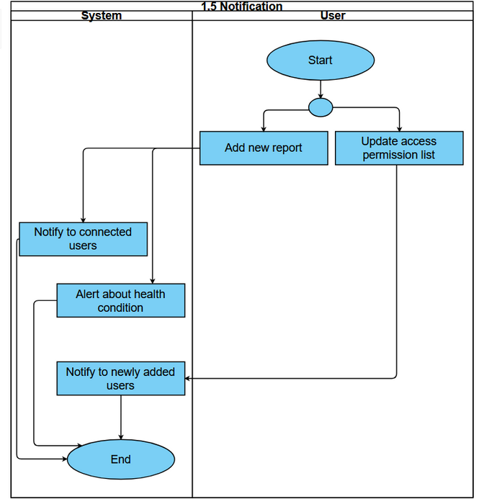
Activity level 1.5
Notification

Slide 31
Databased Modeling

Slide 32
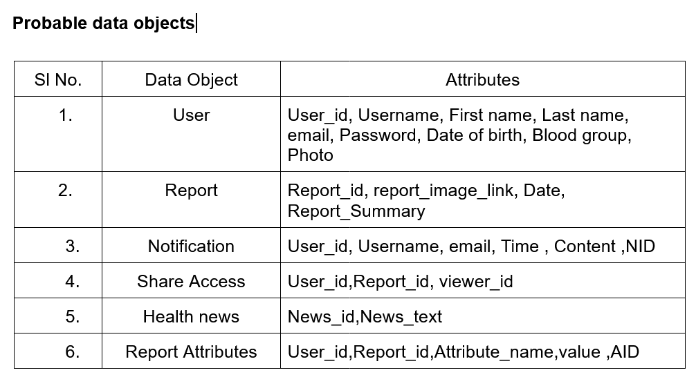
Data Object

Slide 33
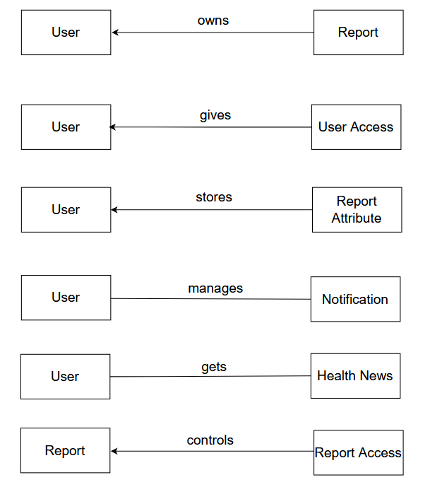
Database Relations

Slide 34
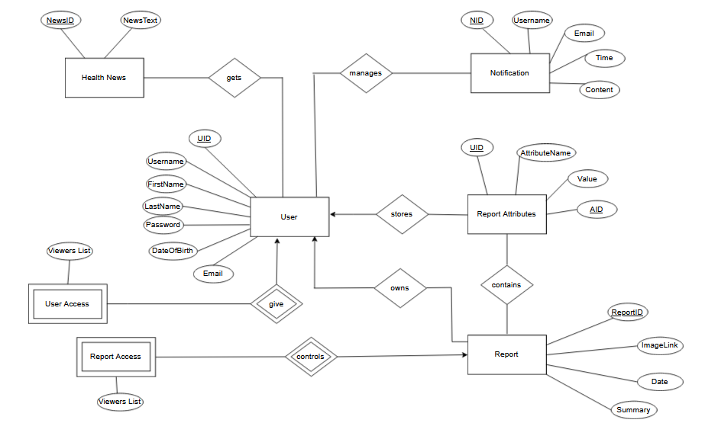
ER Diagram

Slide 35
Class based Modeling

Slide 36
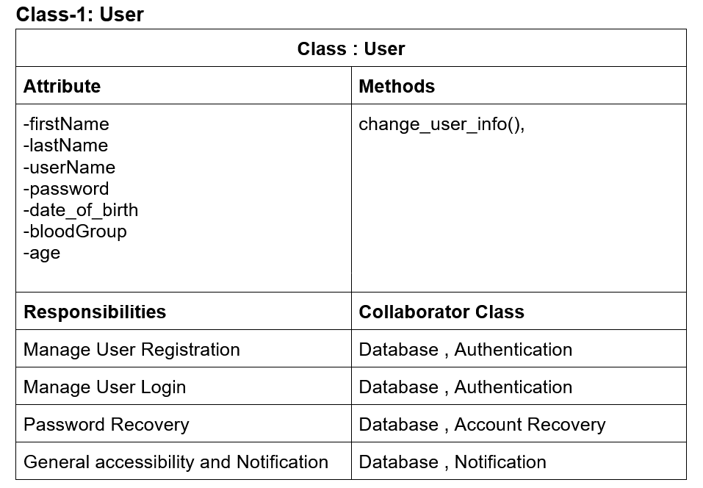
Class-1: User

Slide 37
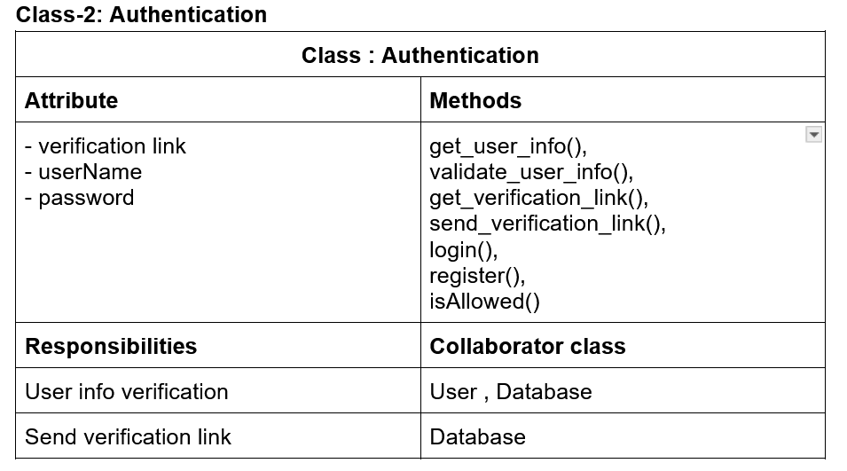
Class-2: Authentication

Slide 38
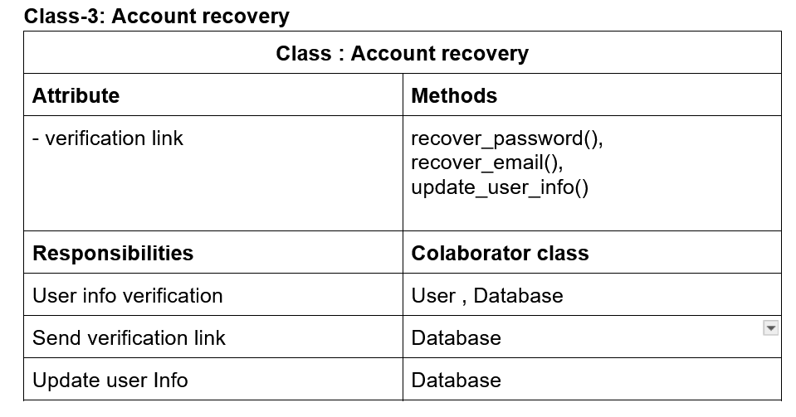
Class-3: Account recovery

Slide 39
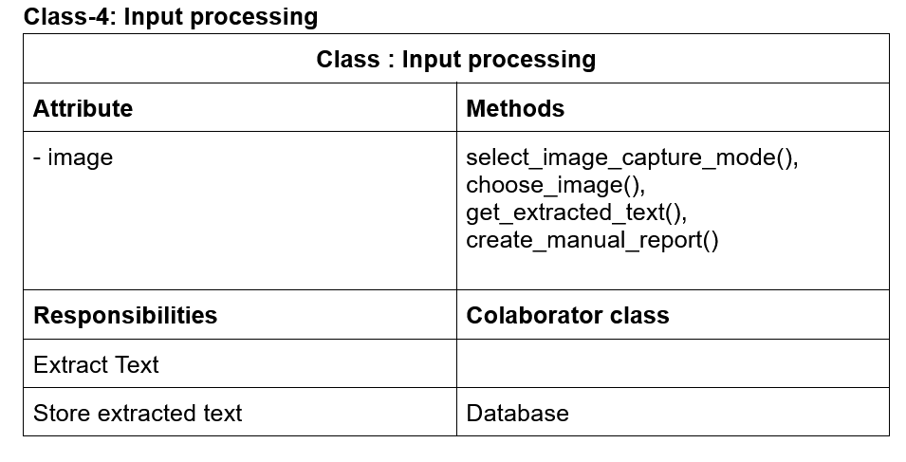
Class-4: Input processing

Slide 40
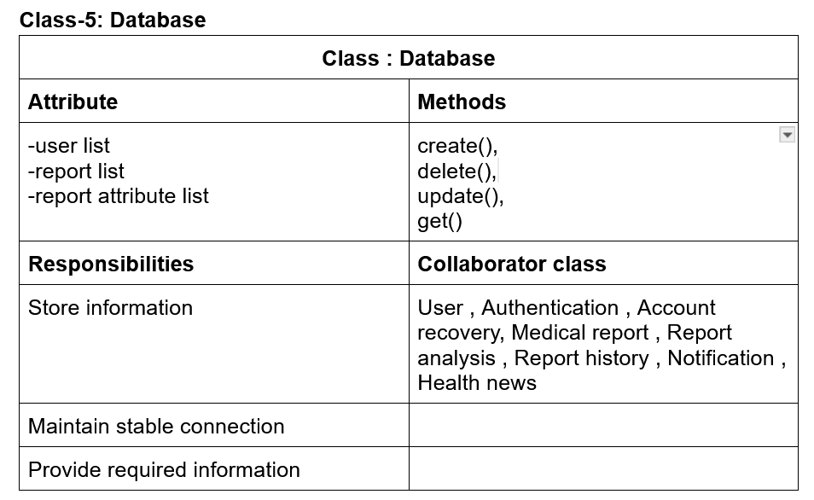
Class-5: Database

Slide 41
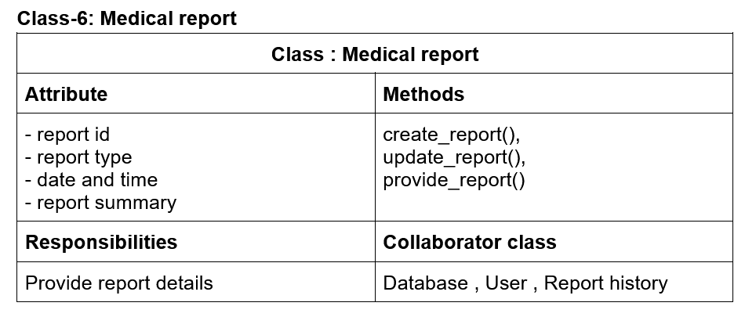
Class-6: Medical report

Slide 42
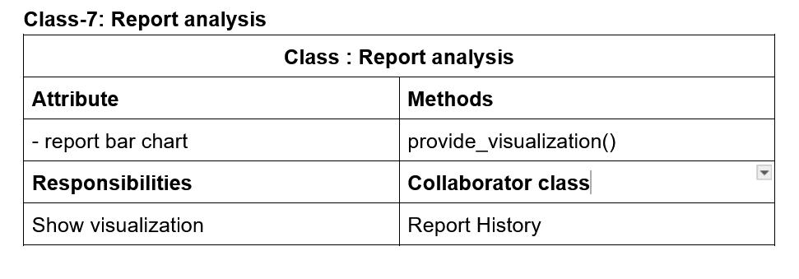
Class-7: Report analysis

Slide 43
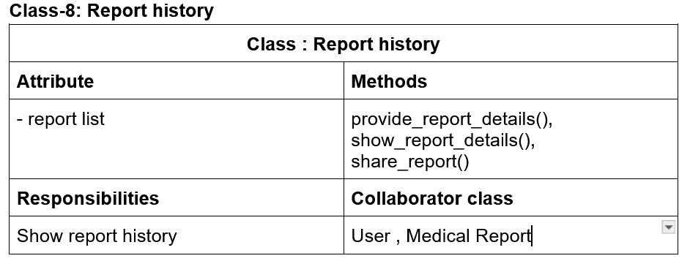
Class-8: Report history

Slide 44
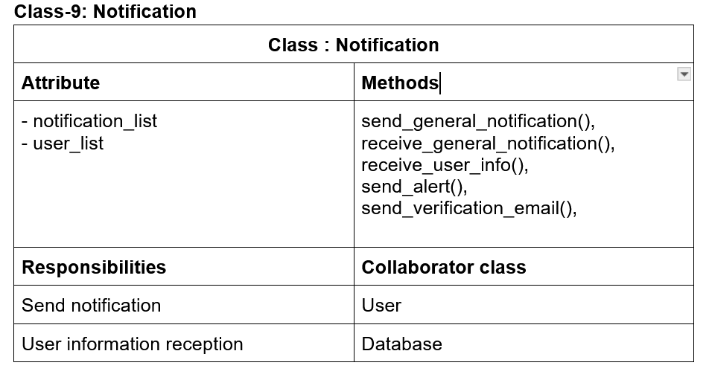
Class-9: Notification

Slide 45
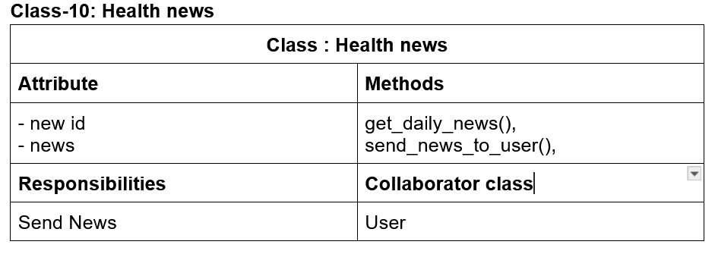
Class-10: Health news

Slide 46
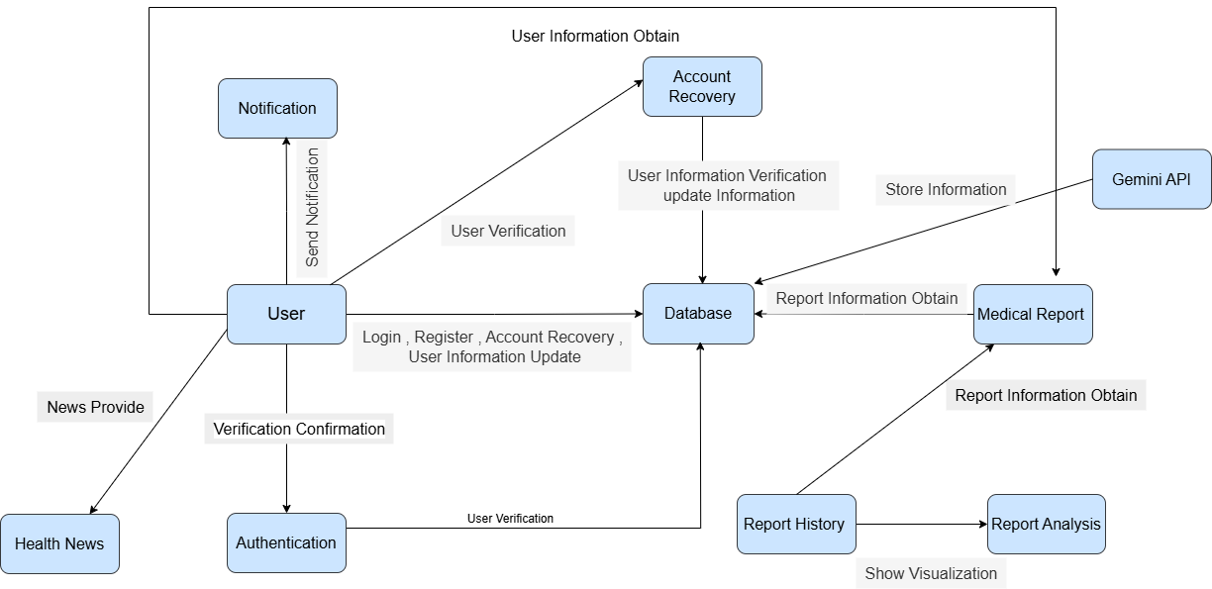
CRC Diagram

Slide 47
Behavioral Modeling

Slide 48
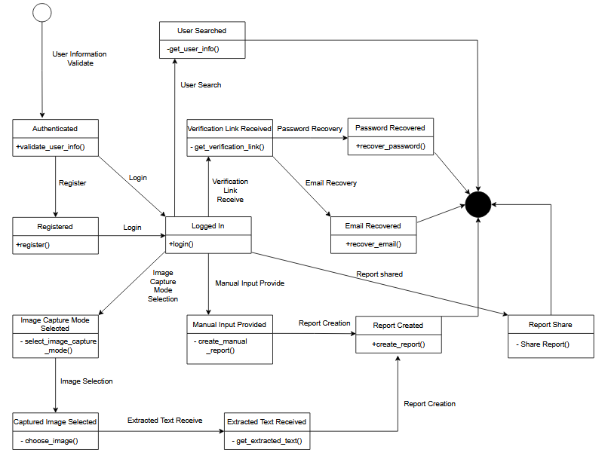
State Transition Diagram

Slide 49
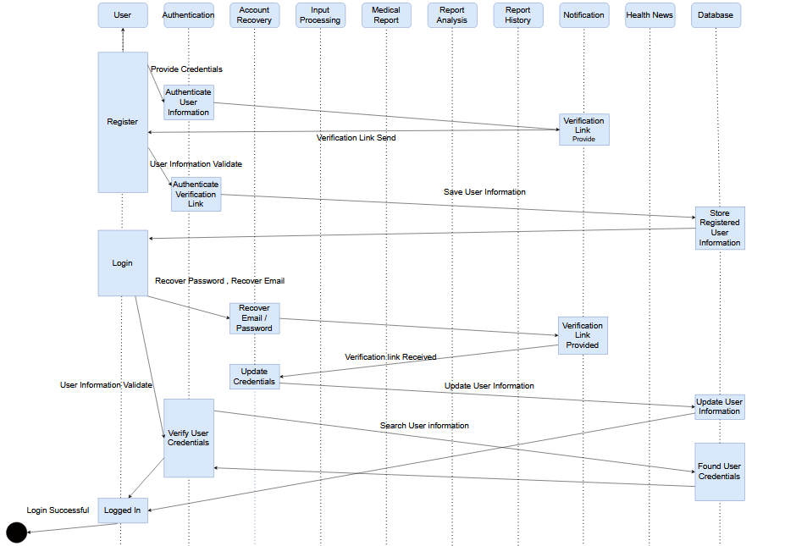
Sequence Diagram

Slide 50
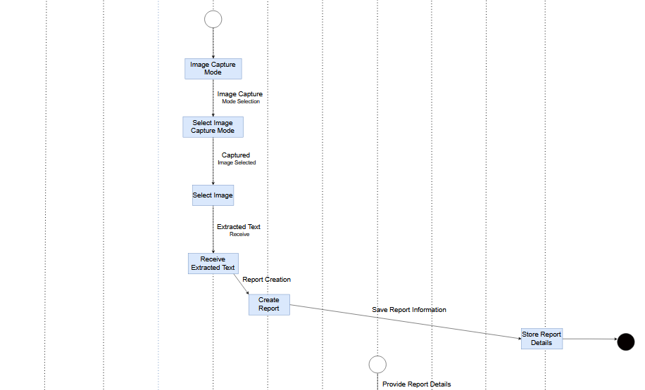
Sequence Diagram

Slide 51
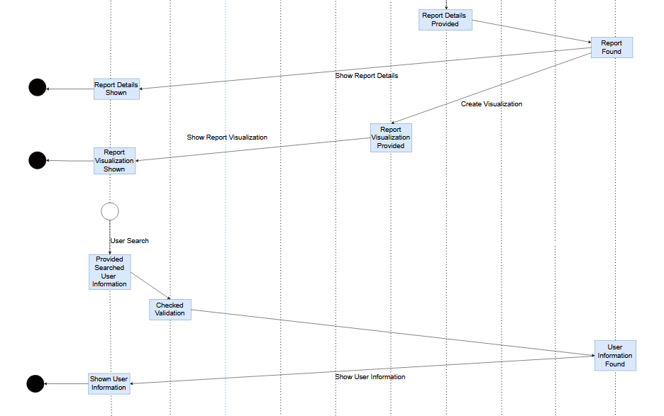
Sequence Diagram

Slide 52
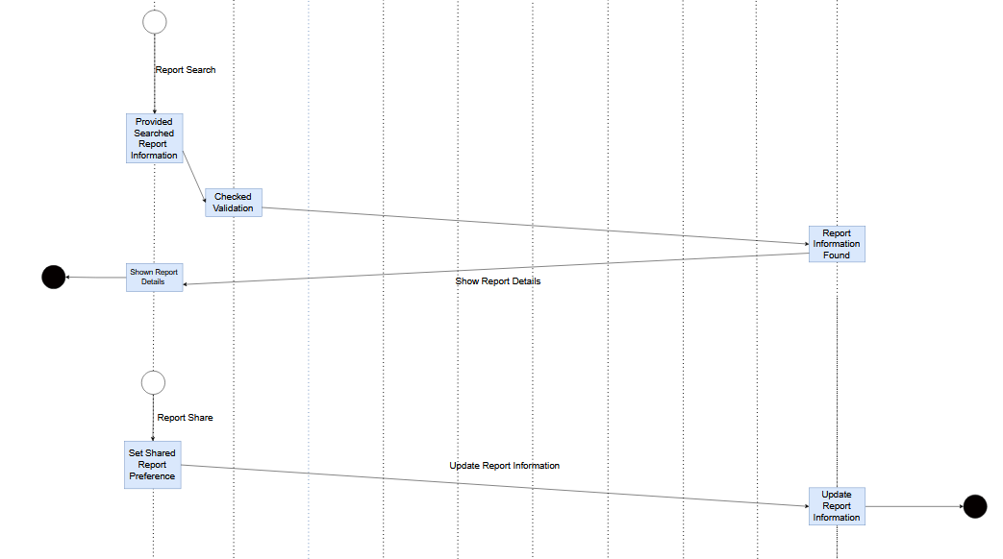
Sequence Diagram

Slide 53
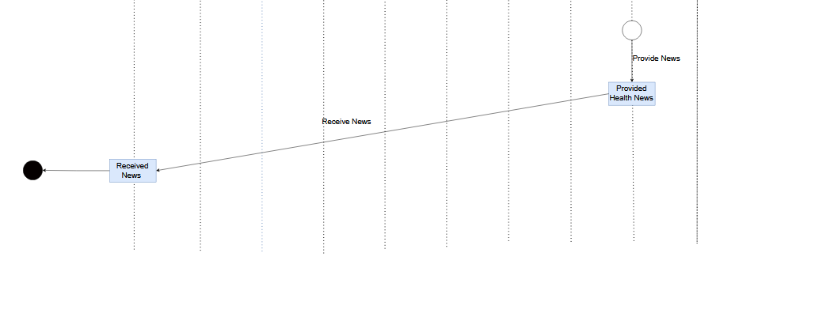
Sequence Diagram

Slide 54
Data Flow Diagram

Slide 55
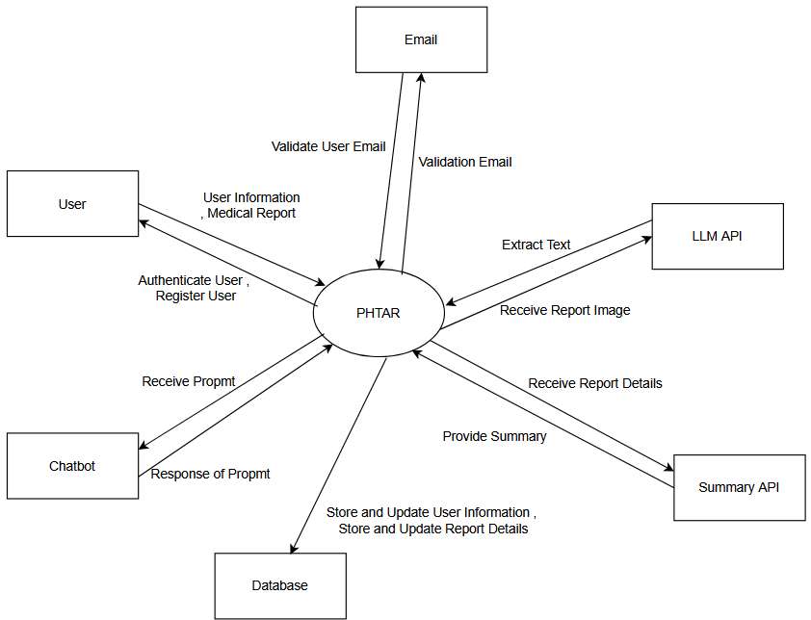
DFD level 0
PHTAR

Slide 56
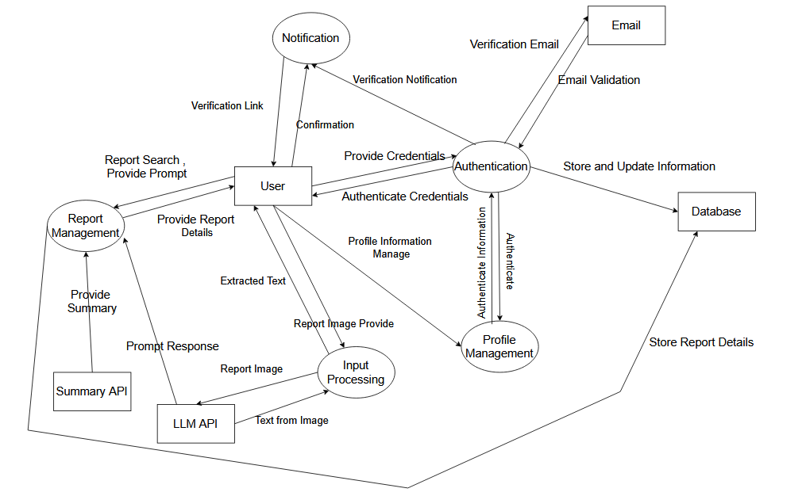
DFD level 1
PHTAR

Slide 57

Thank You

